Slide 1
Activities of Daily Living (ADL)
Department of Computer Science, UET Lahore

Slide 2
Definition
The activities of daily living (ADLs) is a term used to collectively describe fundamental skills required to independently care for oneself, such as eating, bathing, and mobility.
The term activities of daily living was first coined by Sidney Katz in 1950.
Activities of daily living (ADLs) are essential and routine tasks that most young, healthy individuals can perform without assistance.
ADL is used as an indicator of a person’s functional status.
In 2011, the United States National Health Interview Survey determined that 20.7% of adults aged 85 or older, 7% of those aged 75 to 84, and 3.4% of those aged 65 to 74 needed help with ADLs.

Slide 3
Types of ADL
ADLs are classified into two categories:
Basic ADLs OR Physical ADLs
Those skills required to manage one’s basic physical needs,
Examples: personal hygiene or grooming, dressing, toileting, transferring or ambulating, and eating
Instrumental ADL
More complex activities related to the ability to live independently in the community.
Managing finances and medications, food preparation, housekeeping, laundry.

Slide 4
Basic ADL
Basic ADL includes the following categories:
Ambulating: Individual’s ability to move from one position to another and walk independently.
Feeding: The ability of a person to feed oneself.
Dressing: The ability to select appropriate clothes and to put the clothes on.
Personal hygiene: Ability to bathe and groom oneself ,dental hygiene, nail, and hair care.
Continence: The ability to control bladder and bowel function
Toileting: The ability to get to and from the toilet, using it appropriately, and cleaning oneself.

Slide 5
Instrumental ADL
Instrumental ADL includes the following categories:
Transportation and shopping: Ability to procure groceries, attend events Managing transportation, either via driving or by organizing other means of transport.
Managing finances: This includes the ability to pay bills and managing financial assets.
Shopping and meal preparation, i.e., everything required to get a meal on the table. It also covers shopping for clothing and other items required for daily life.
Housecleaning and home maintenance. Cleaning kitchens after eating, maintaining living areas reasonably clean and tidy, and keeping up with home maintenance.
Managing communication with others: The ability to manage telephone and mail.
Managing medications: Ability to obtain medications and taking them as directed.
https://www.ncbi.nlm.nih.gov/books/NBK470404/

Slide 6
Vision-based human activity recognition: a survey
Department of Computer Science, UET Lahore

Slide 7
Abstract
This paper attempts to review and summarize the progress of HAR systems from the computer vision perspective.
Computer vision applications such as human computer interaction, virtual reality, security, video surveillance and home monitoring are highly correlated to HAR tasks.
Up to date analysis of vision-based HAR related literature and recent progress in the field.
highlight the main challenges and future directions
https://link.springer.com/article/10.1007/s11042-020-09004-3
Notes:
https://link.springer.com/article/10.1007/s11042-020-09004-3

Slide 8
HAR(Human Activity Recognition) Application
A speaker can control the presentation of the slides with the movements of his hand
recognition of human activity from static images or video sequences
monitoring and evaluation of processes in industry as well as machines and devices control
Fraud detection
Extraction of information from videos
Crowds’ movements are tracked to detect violent or criminal situation

Slide 9
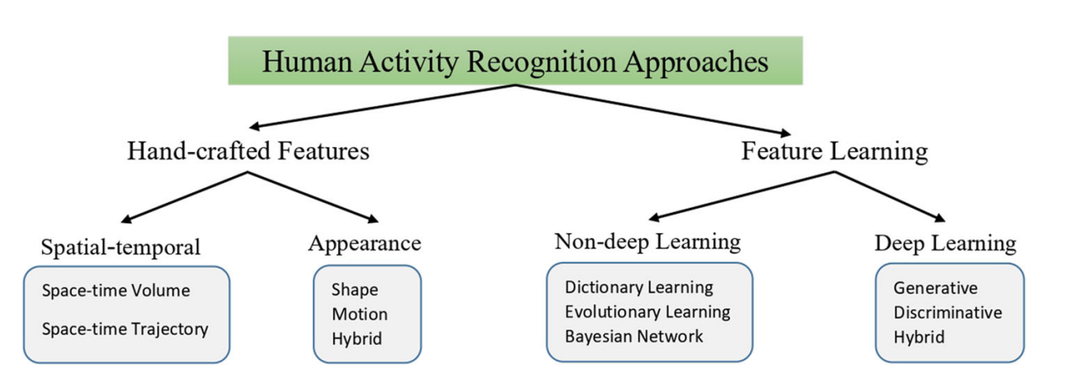
HAR Approaches
It’s composed of 3 important components:
Video frame segmentation for action detection
Action representation with respect to posture and motion of the human body.
Learning process that recognizes these actions
Another Approach
Background Subtraction: Separating invariant background from moving objects.
Human Tracking: Locating human motion over time.
Human Action and Object Detection: Localizing human activities in images.

Slide 10
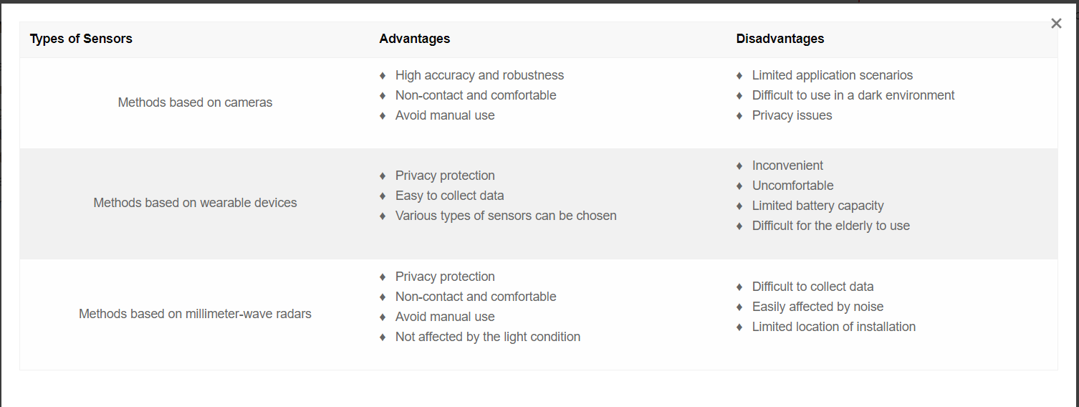
Different Approaches to Monitor HAR

Slide 11
Human Activity Categorization
Gestures: Primitive body movements corresponding to specific actions.
Atomic Actions: Basic movements that can be part of complex activities.
Human-to-Object/Human-to-Human Interactions: Activities involving multiple people or objects.
Group Actions: Activities performed by a group of individuals.
Human Behaviors: Actions linked to emotions, personality, and psychological state.
Events: High-level activities describing social actions and intentions.

Slide 12
How to Monitor Using cameras?
Some researchers separated the image background from the human and then used machine learning or deep learning to extract features.
Espinosa et al. [7] separated the person in the picture from the background and extracted the ratio of length to width of the human body to recognize standing and falling.
some researchers extracted human contour features and recognized activities through changes in contour
Rougier et al. [11] used an ellipse rather than a bounding box on HAR. They suggested that the direction standard deviation and ratio standard deviation of the ellipse can better recognize the fall.
Lai et al. [12] improved this method by extracting the picture’s features and using three points to represent people instead of using the bounding box.
https://encyclopedia.pub/entry/25786#:~:text=Activity%20Recognition%20Methods-,Many%20researchers%20have%20studied%20HAR%20from%20different%20aspects%2C%20such%20as,%2C%20and%20millimeter%2Dwave%20radars.

Slide 13
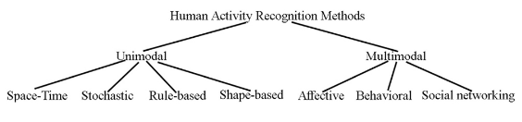
Uni-Modal & Multi-modal Methods
Based on categories, its further divided into Uni-modal and multi-modal methods
Unimodal human activity recognition methods identify human activities from data of one modality.
Multimodal methods in action recognition refer to techniques that combine information from multiple sources or modalities to improve the accuracy and robustness of recognizing human actions or activities.

Slide 14
Further classification of Uni-Modal Methods
Space-Time Approaches: These methods represent actions as patterns of motion over both space and time in video sequences. They capture the spatial and temporal relationships of motion features.
Stochastic Approaches: Stochastic methods model actions using probabilistic or statistical models. They take into account the uncertainty and variability in motion patterns.
Rule-Based Approaches: Rule-based methods use predefined rules or heuristics to recognize actions. These rules are often based on expert knowledge or patterns observed in the data.
Shape-Based Approaches: Shape-based methods focus on capturing the shape or form of motion patterns. They represent actions as trajectories or curves and compare them to template shapes.

Slide 15
Further classification of Multi-Modal Methods
Affective Methods: These methods focus on recognizing atomic actions or interactions that correspond to affective states of individuals during communication. These methods often rely on emotions and body movements.
Behavioral Methods: Behavioral multimodal methods aim to describe atomic actions or interactions that are indicative of behavioral patterns and actions in individuals.
Methods Based on Social Networking: This category involves methods that leverage multimodal cues to understand social interactions, often exploring how people interact and communicate in social networks.

